Slide 1

Historical Style Generator (HStyle)
Students - Yahav Bar David & Leor Ariel Rose
Academic Advisor - Dr. Irina Rabaev
Project Id - BS-SE-21-89

Slide 2

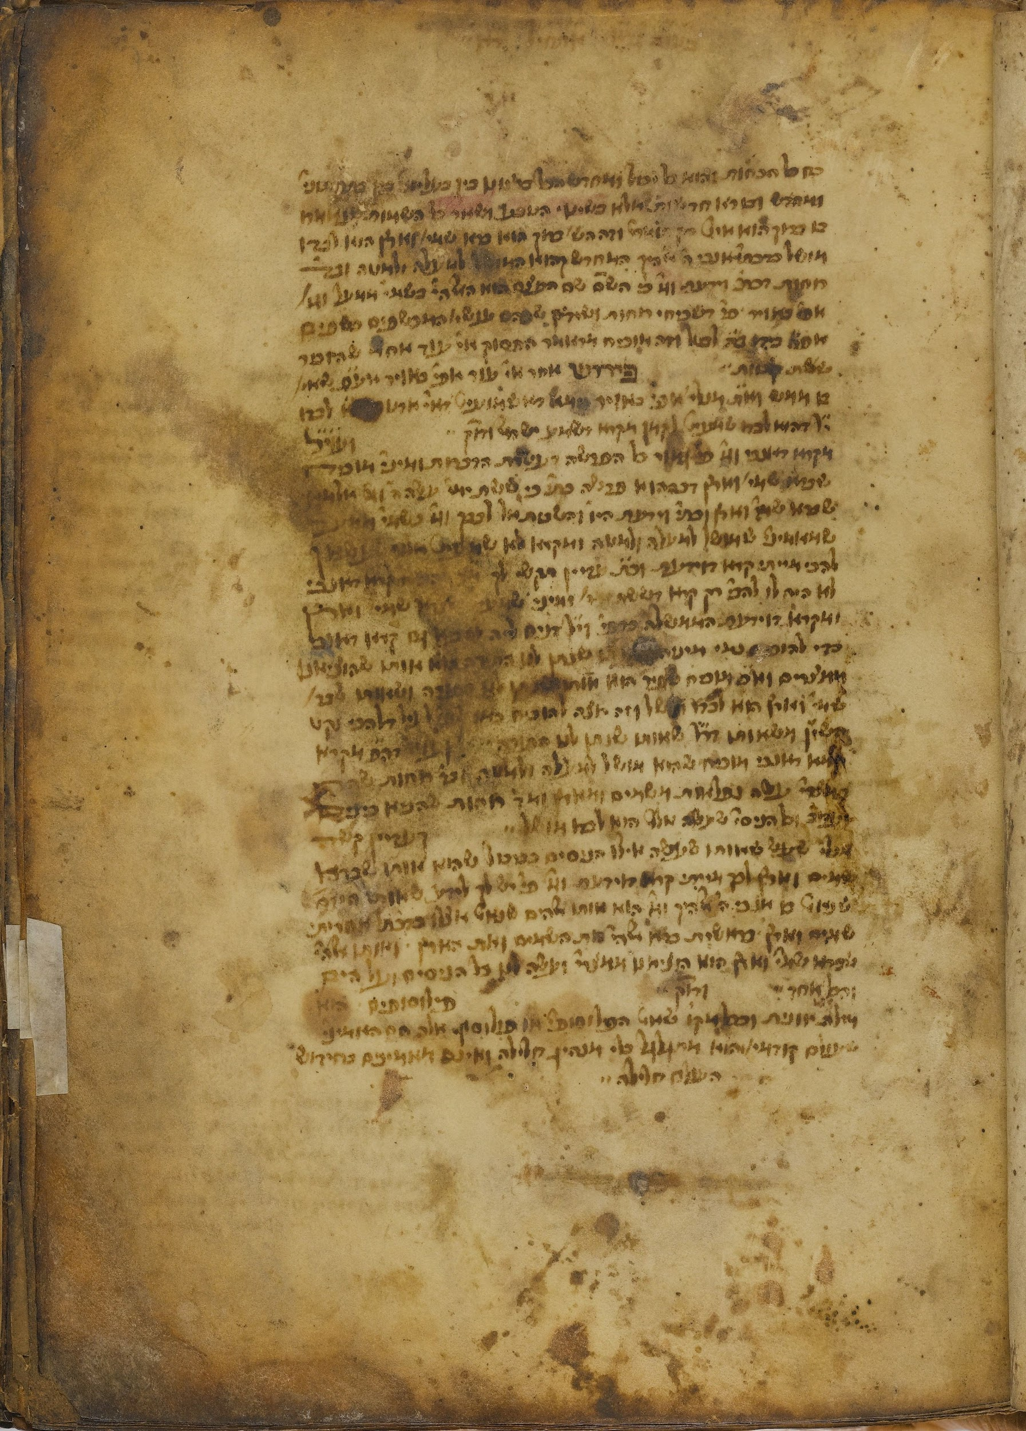
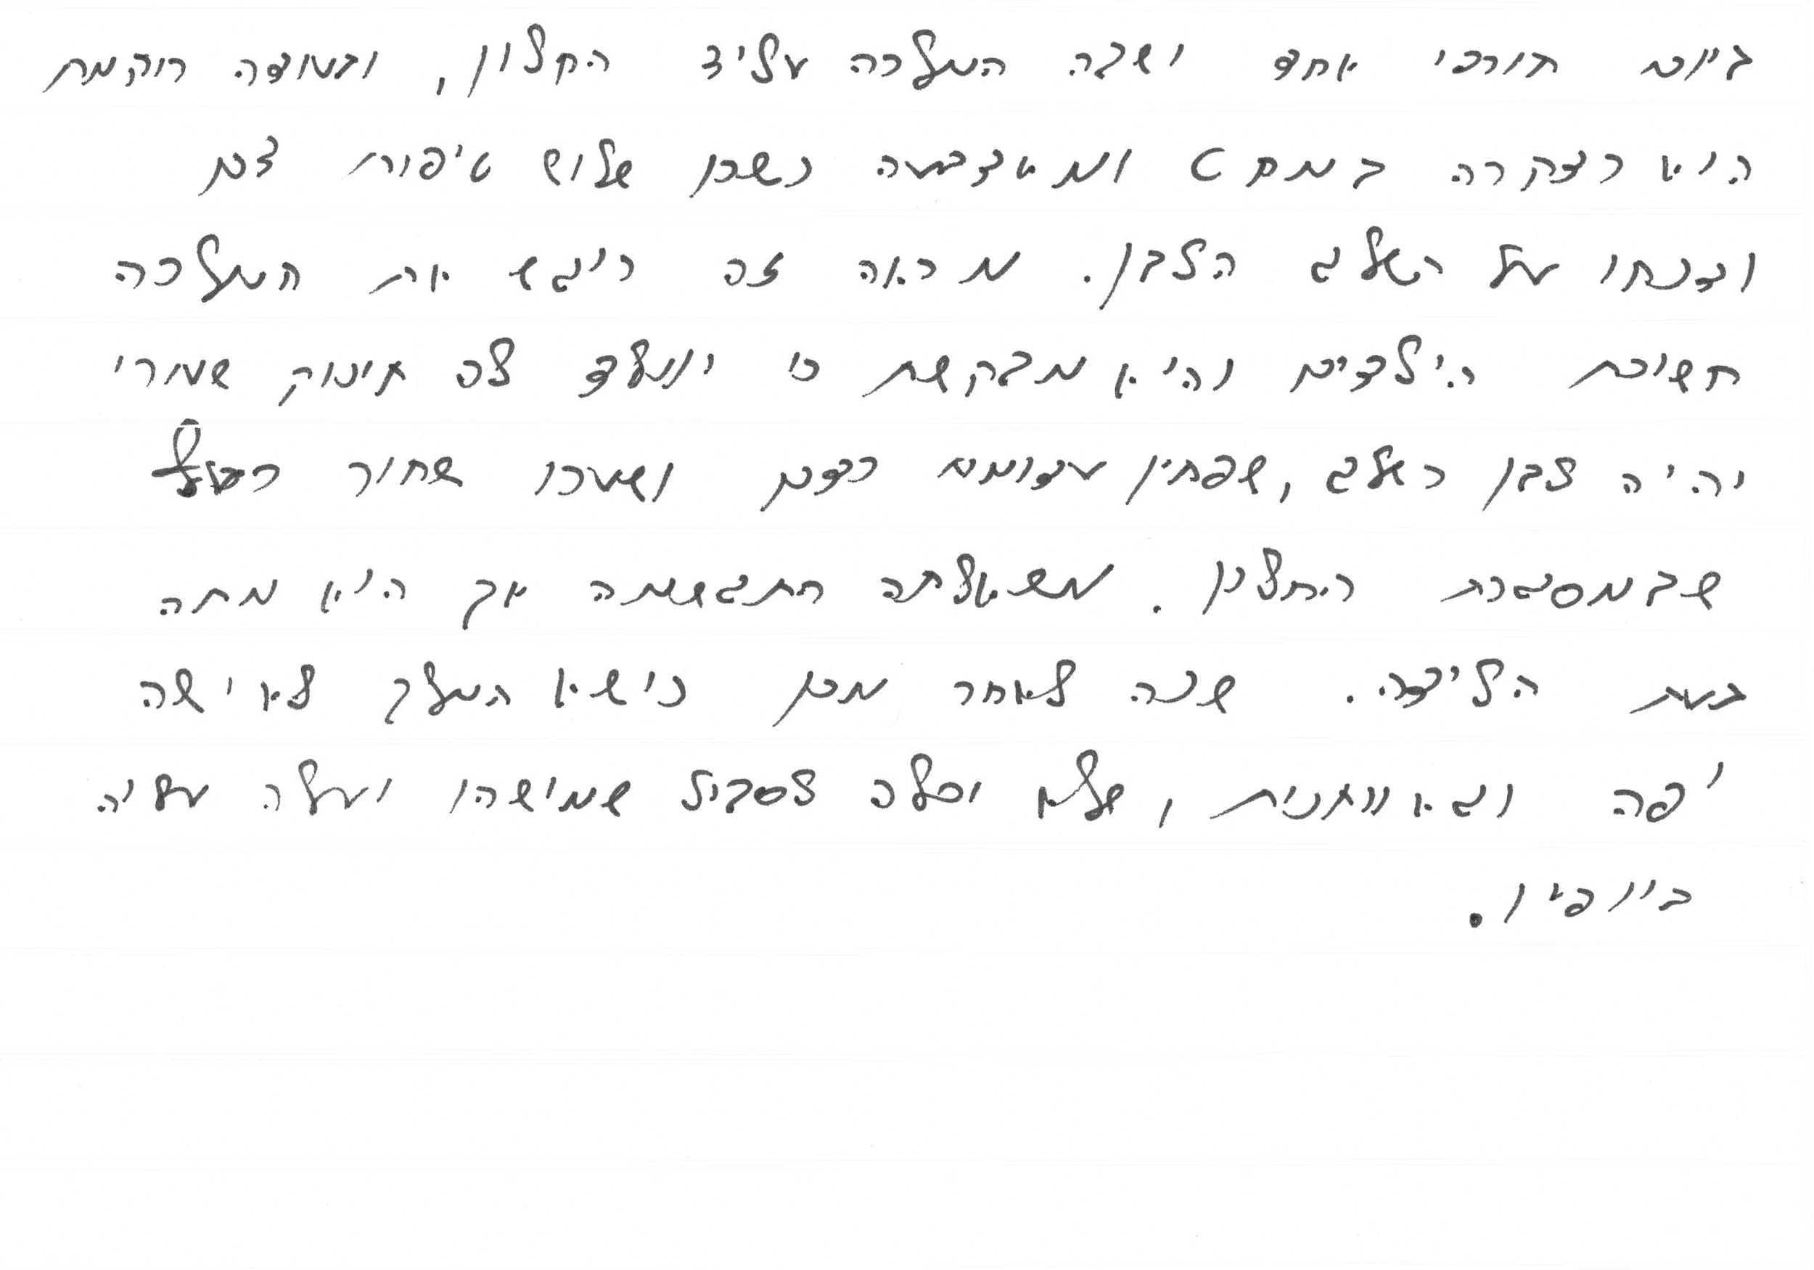
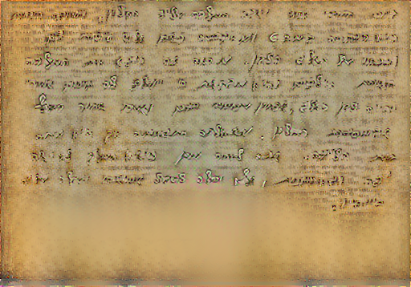
What does historical style generator mean?
Input:
Content image - Modern
Style image - Historical
Output:
Content image with historical style

Slide 3
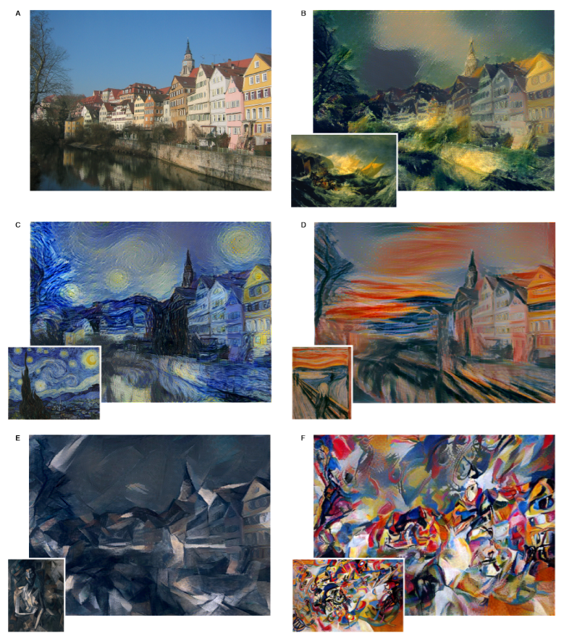
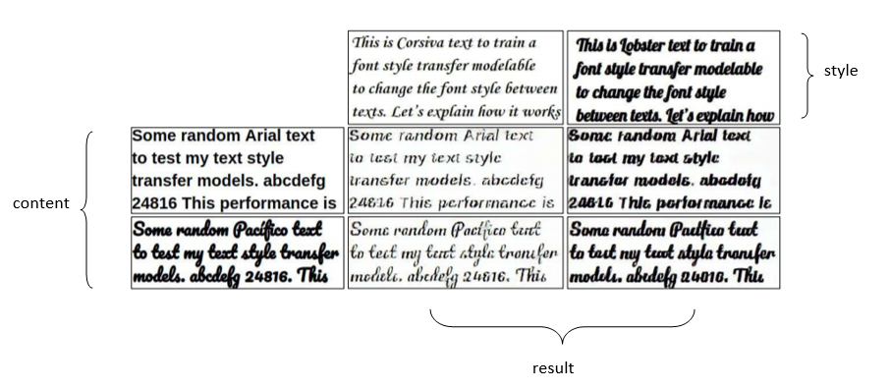
What has been done already in this domain?
Gatys et.al original method (NST)
Grayscale content and grayscale style
NST
GAN

Slide 4
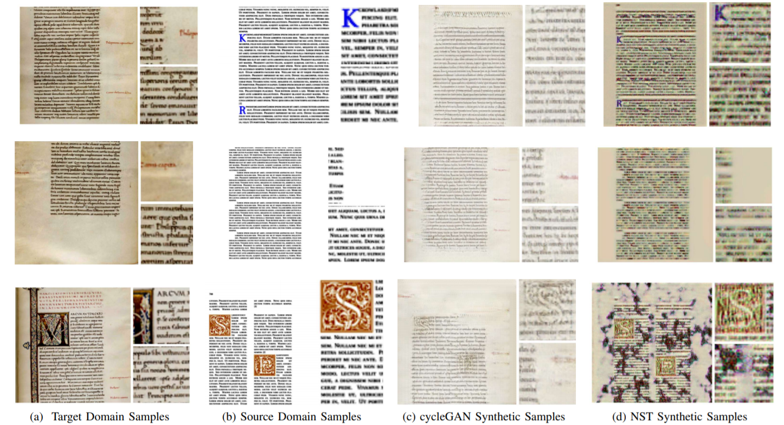
What has been done already in this domain?
Grayscale content and historical document
NST
CycleGan

Slide 5
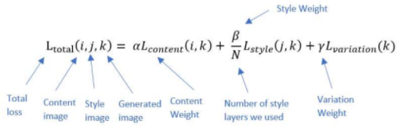
Our Method
First approach - Neural Style Transfer
Deep Learning
Evaluation

Slide 6
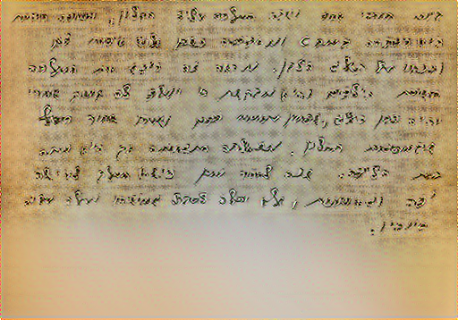
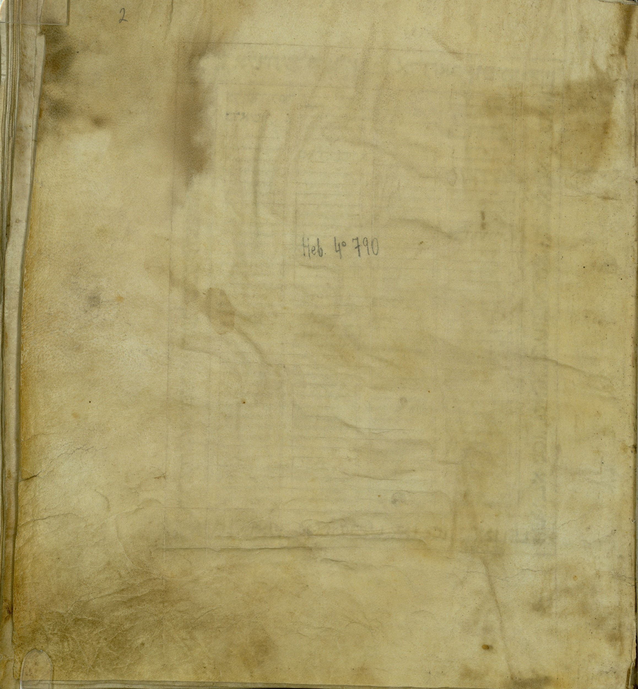
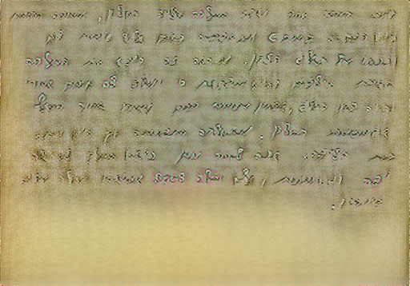
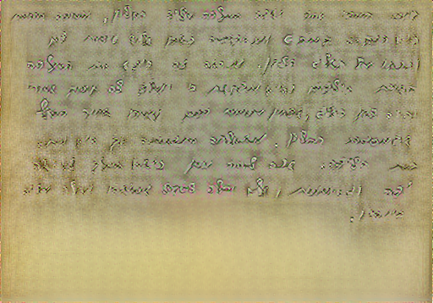
Results (1) - Original content
weight 4 - block3_conv2
weight 5 - block3_conv2
weight 3 - block3_conv2
weight 4 - block3_conv2

Slide 7
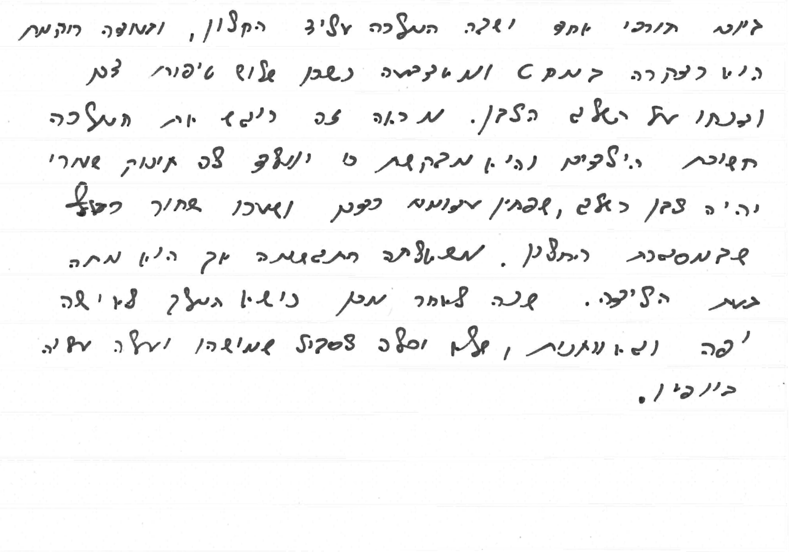
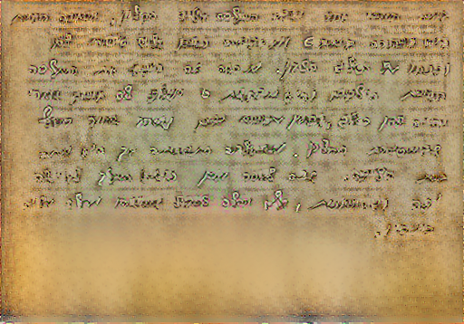
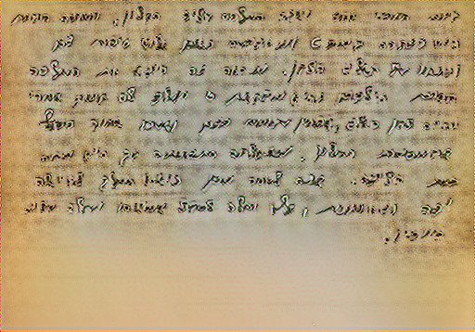
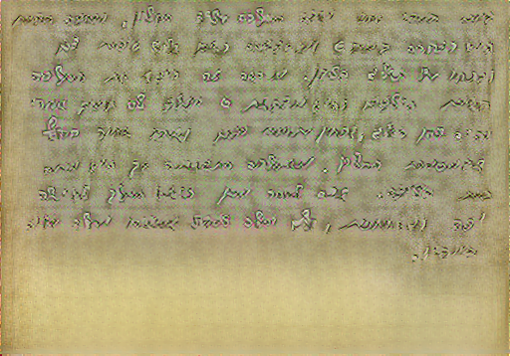
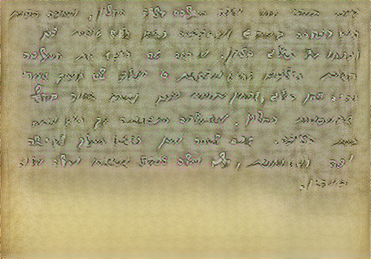
Results (2) - Dilate content
weight 4 - block3_conv2
weight 5 - block3_conv2
weight 3 - block3_conv2
weight 4 - block3_conv2

Slide 8
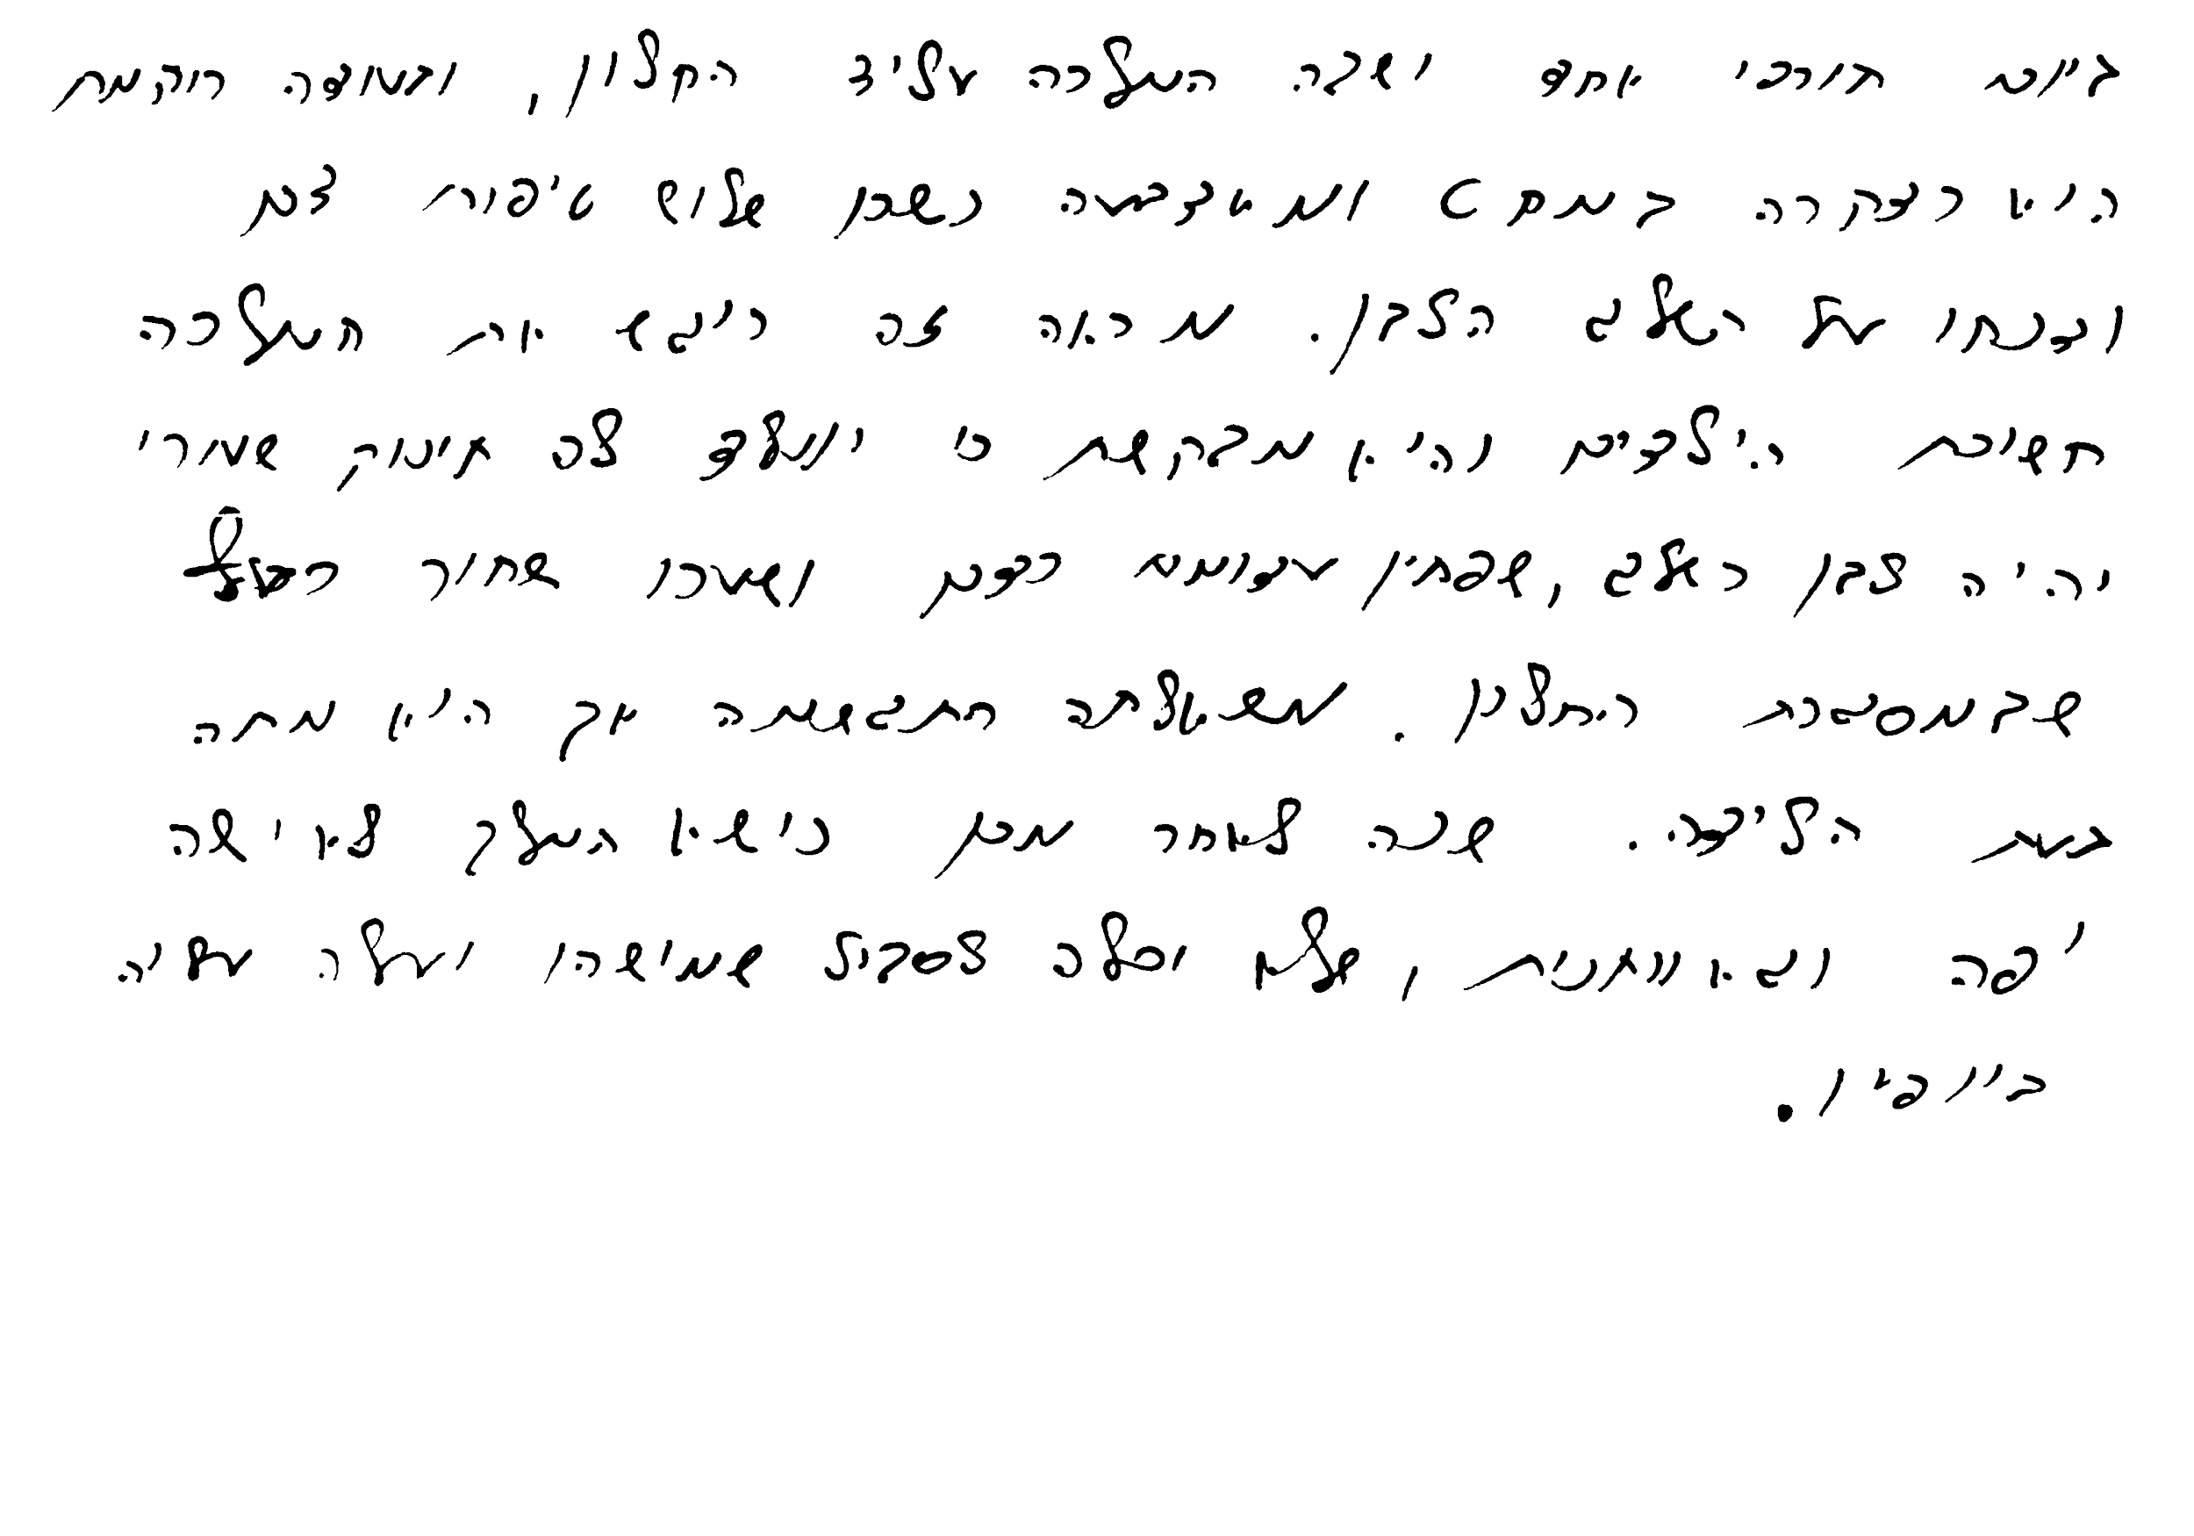
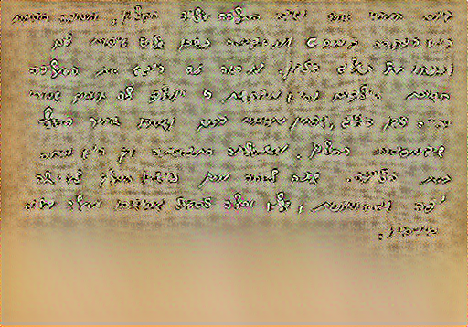
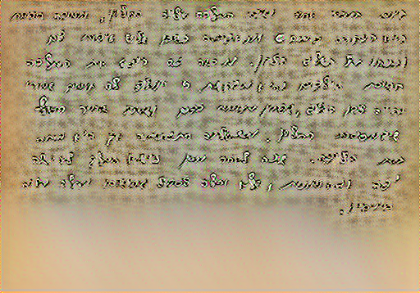
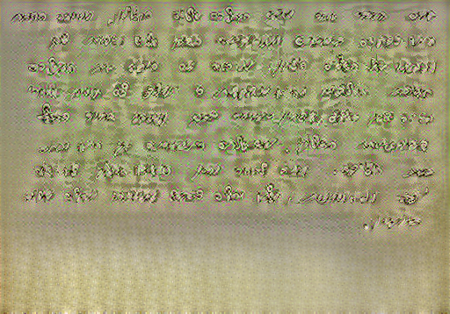
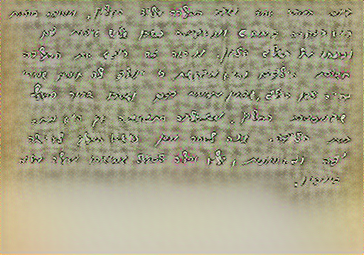
Results (3) - Binary content
weight 5 - block3_conv2
weight 6 - block3_conv2
weight 4 - block4_conv2
weight 5 - block3_conv2

Slide 9
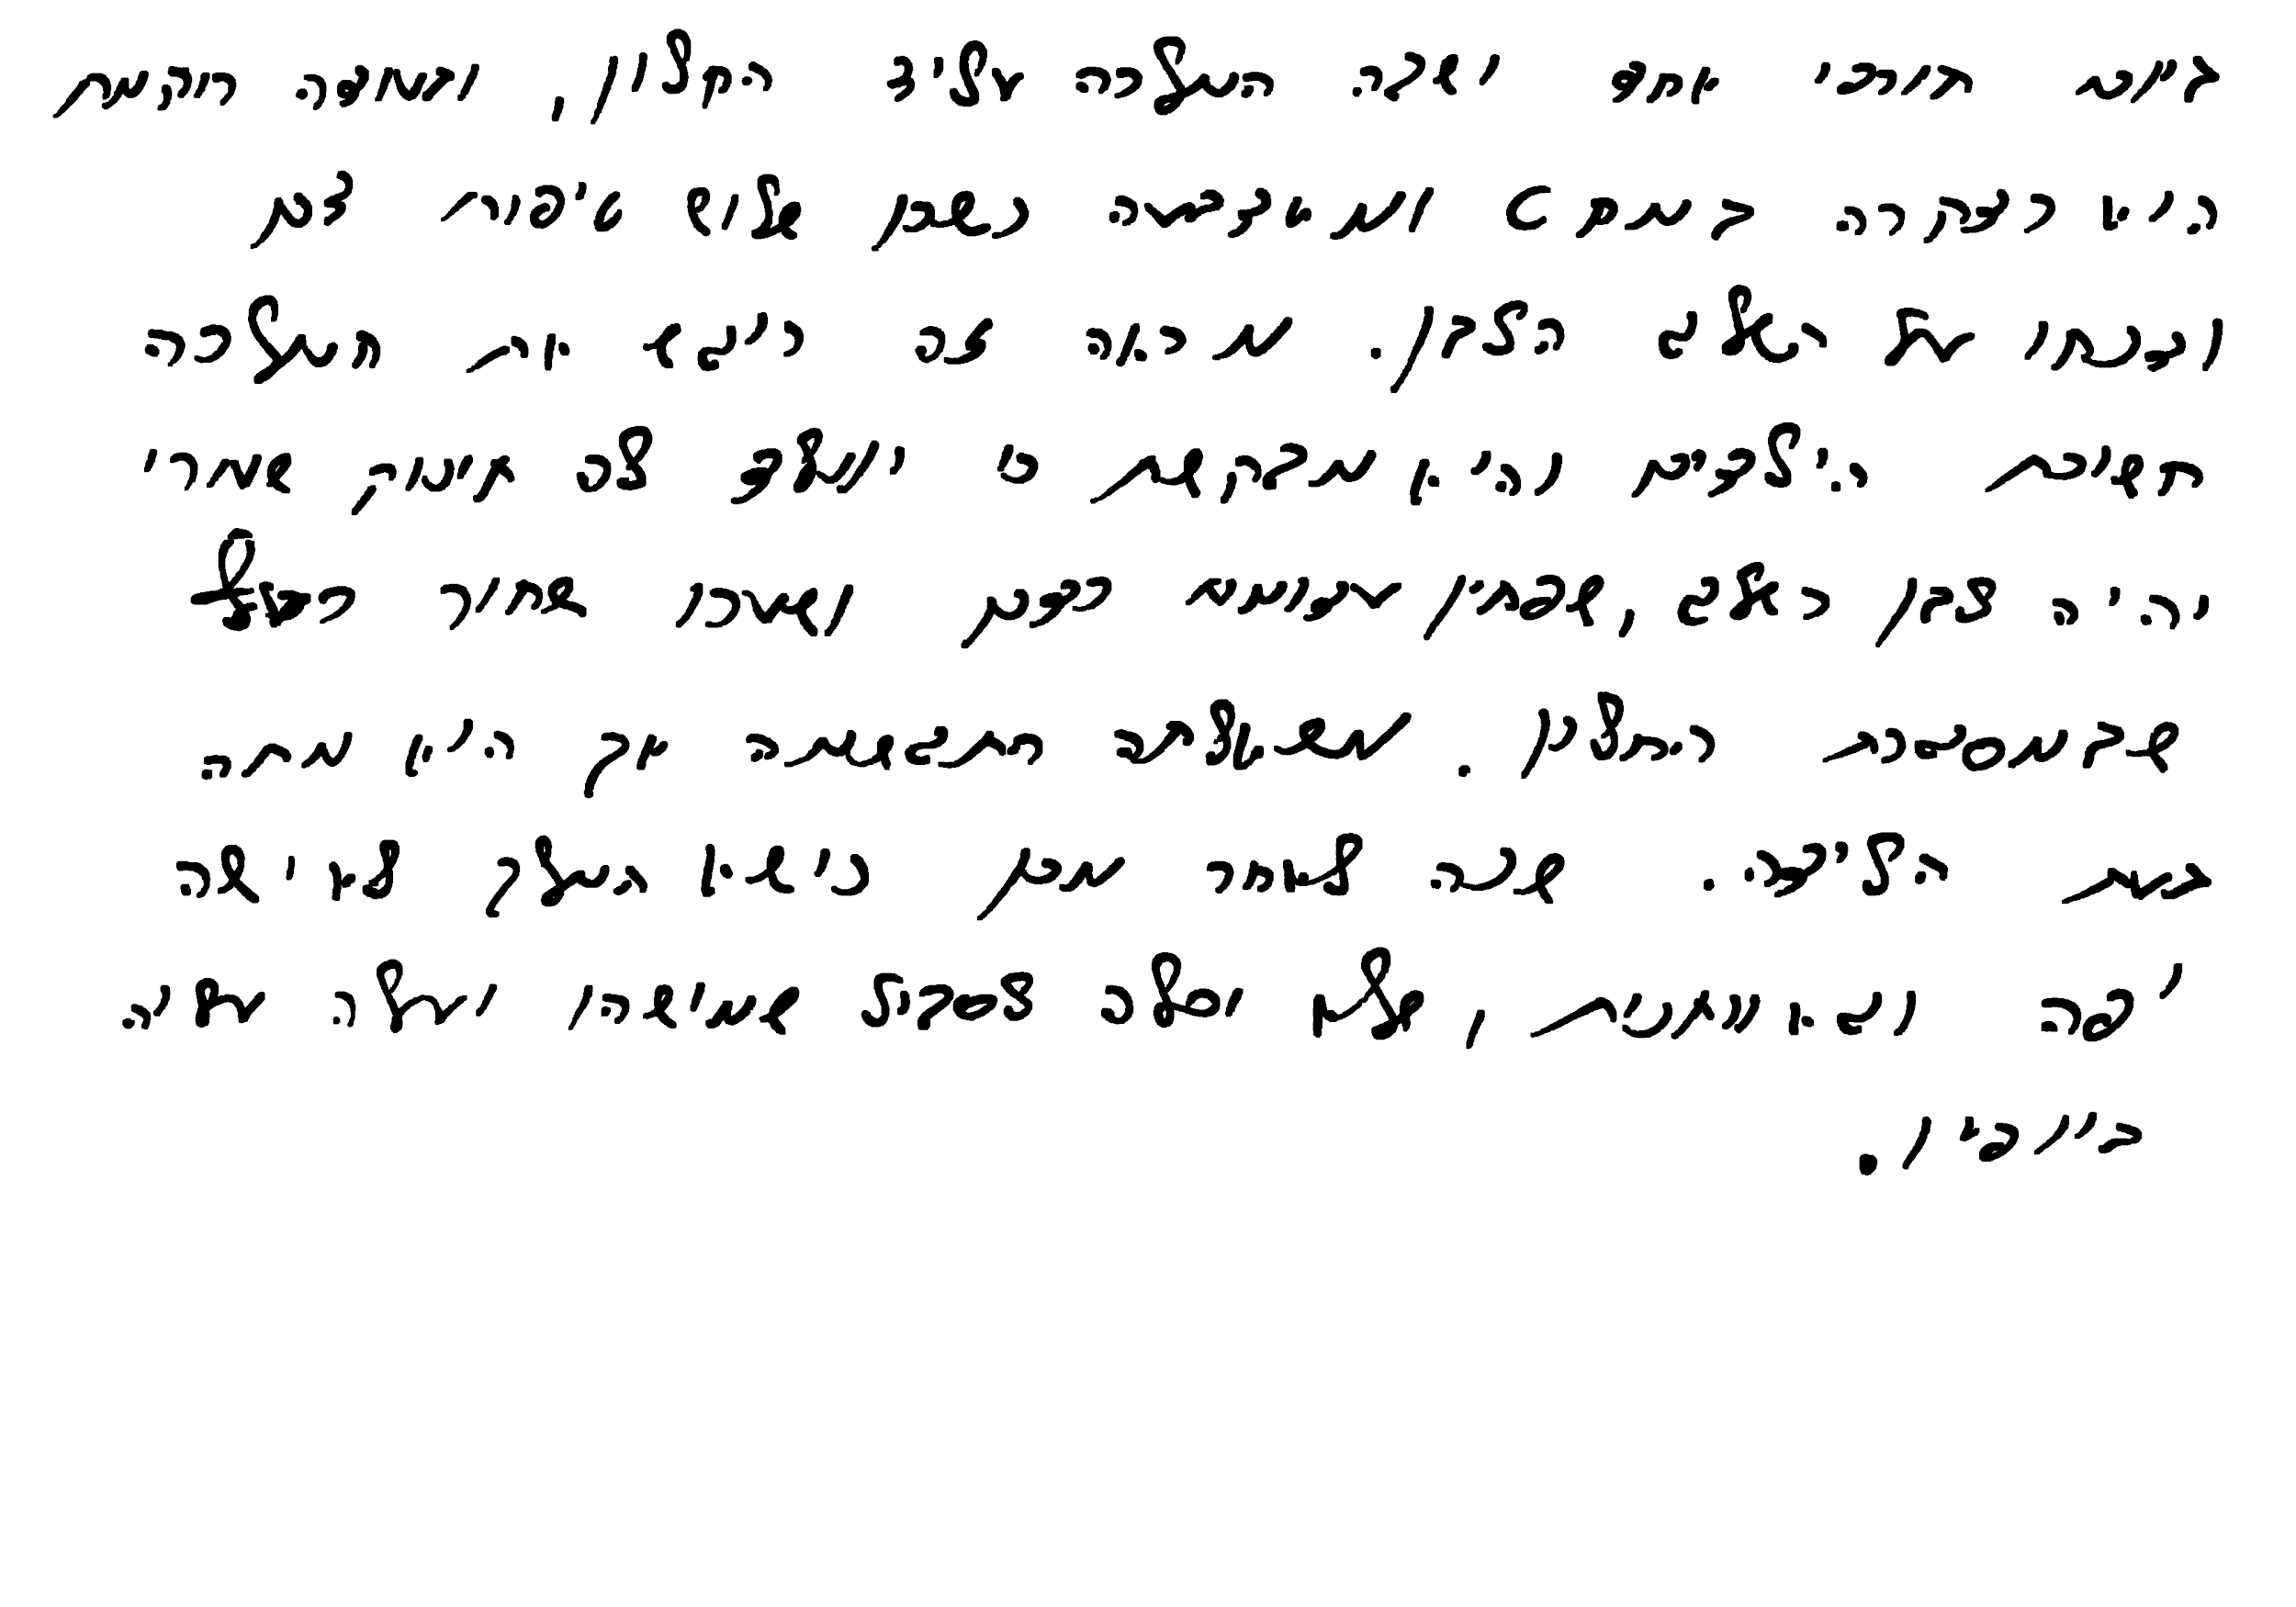
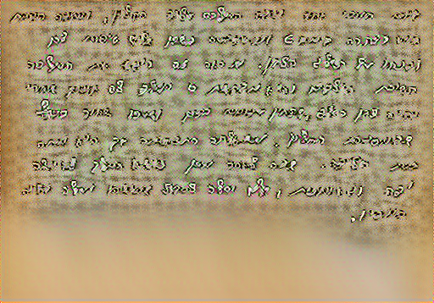
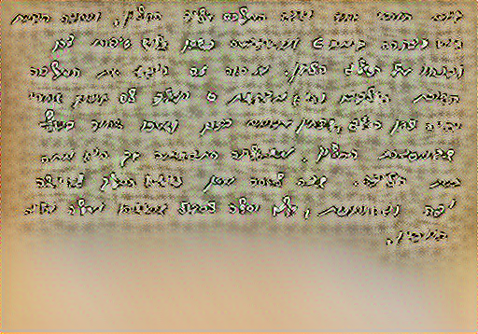
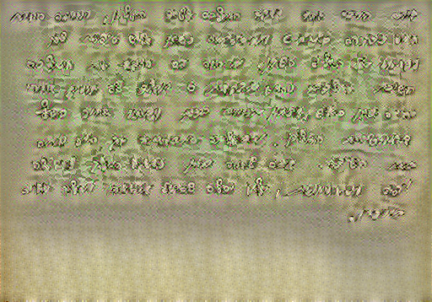
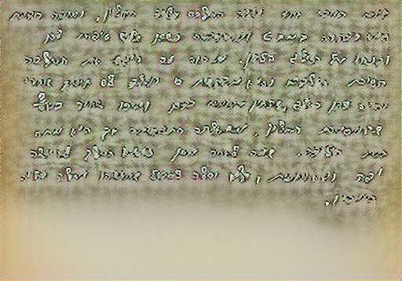
Results (4) - Binary-dilated content
weight 5 - block3_conv2
weight 6 - block3_conv2
weight 4 - block4_conv2
weight 5 - block3_conv2

Slide 10
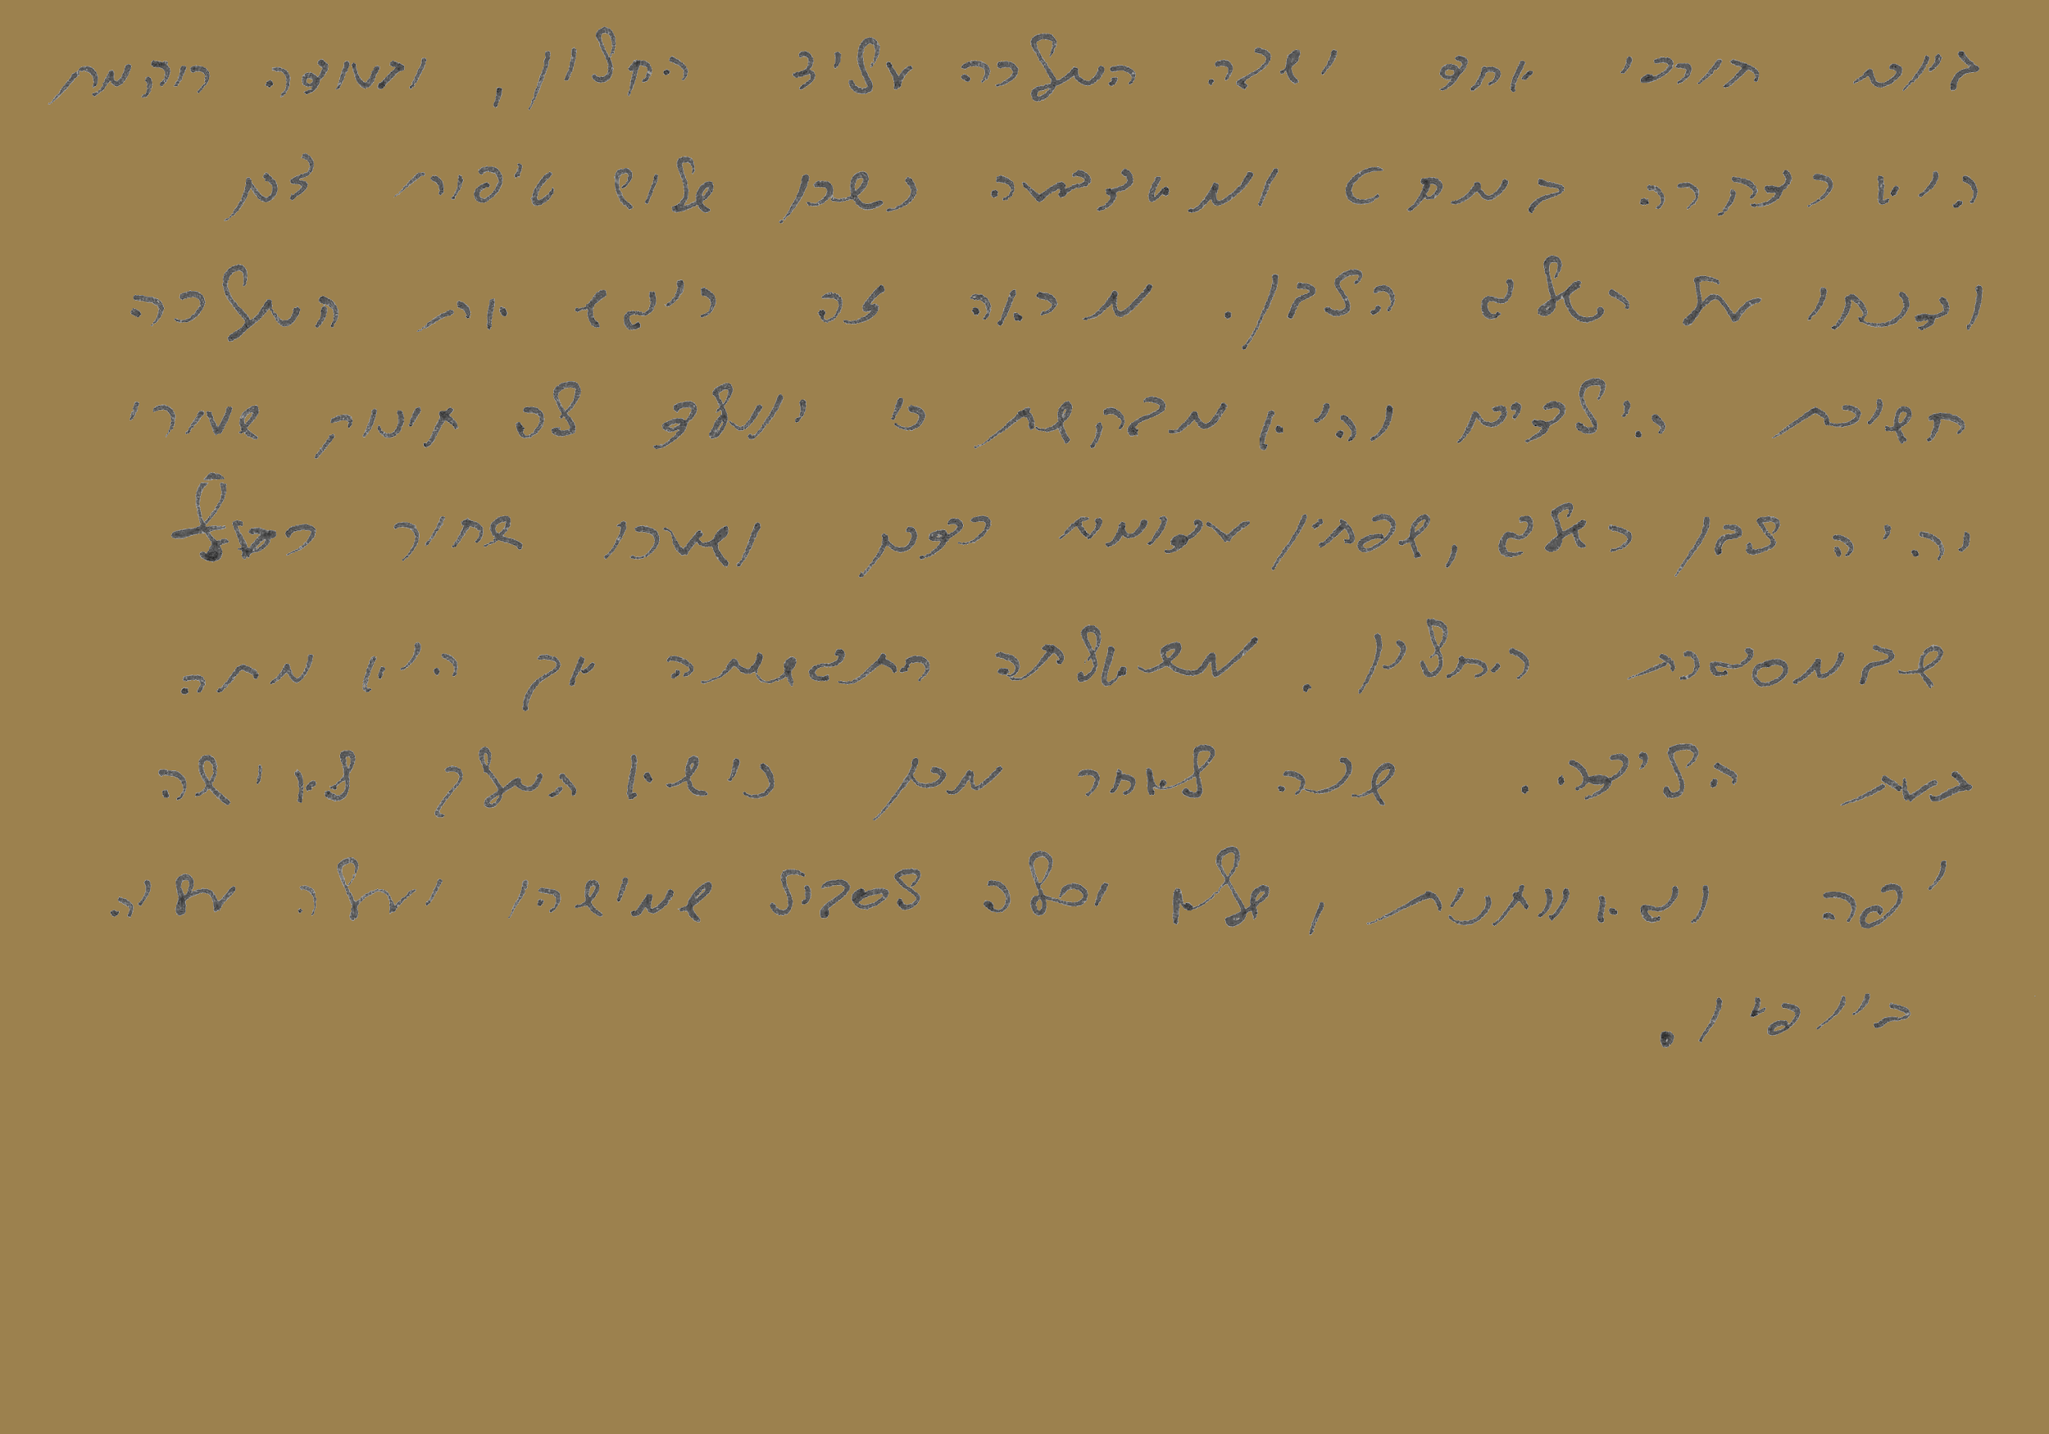
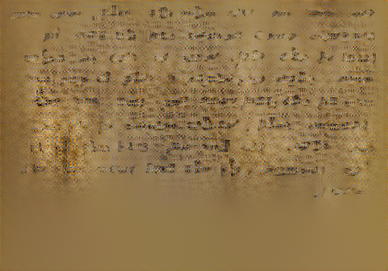
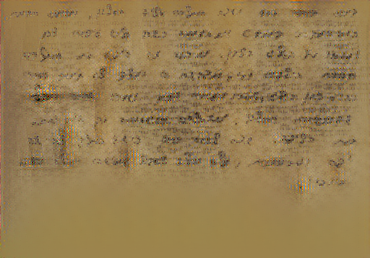
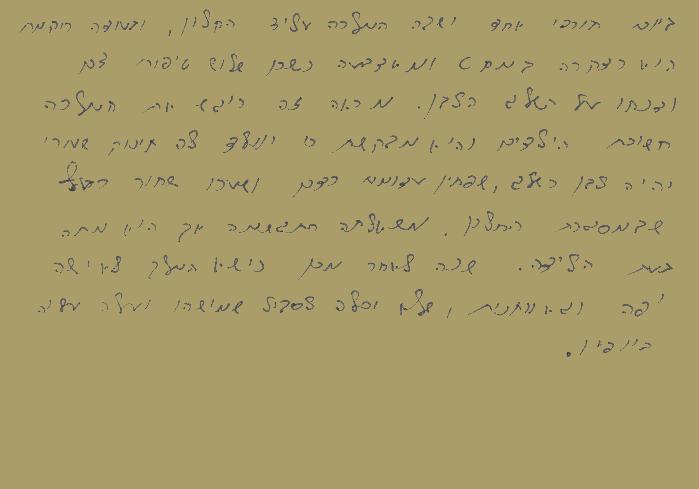
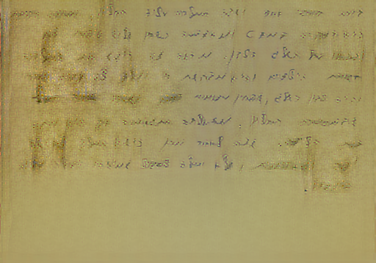
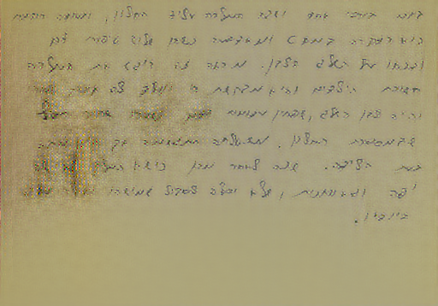
Results (5) -
Average historical pixels background for original content
weight 4 - block3_conv2
weight 6 - block3_conv2
weight 4 - block3_conv2
weight 5 - block3_conv2

Slide 11
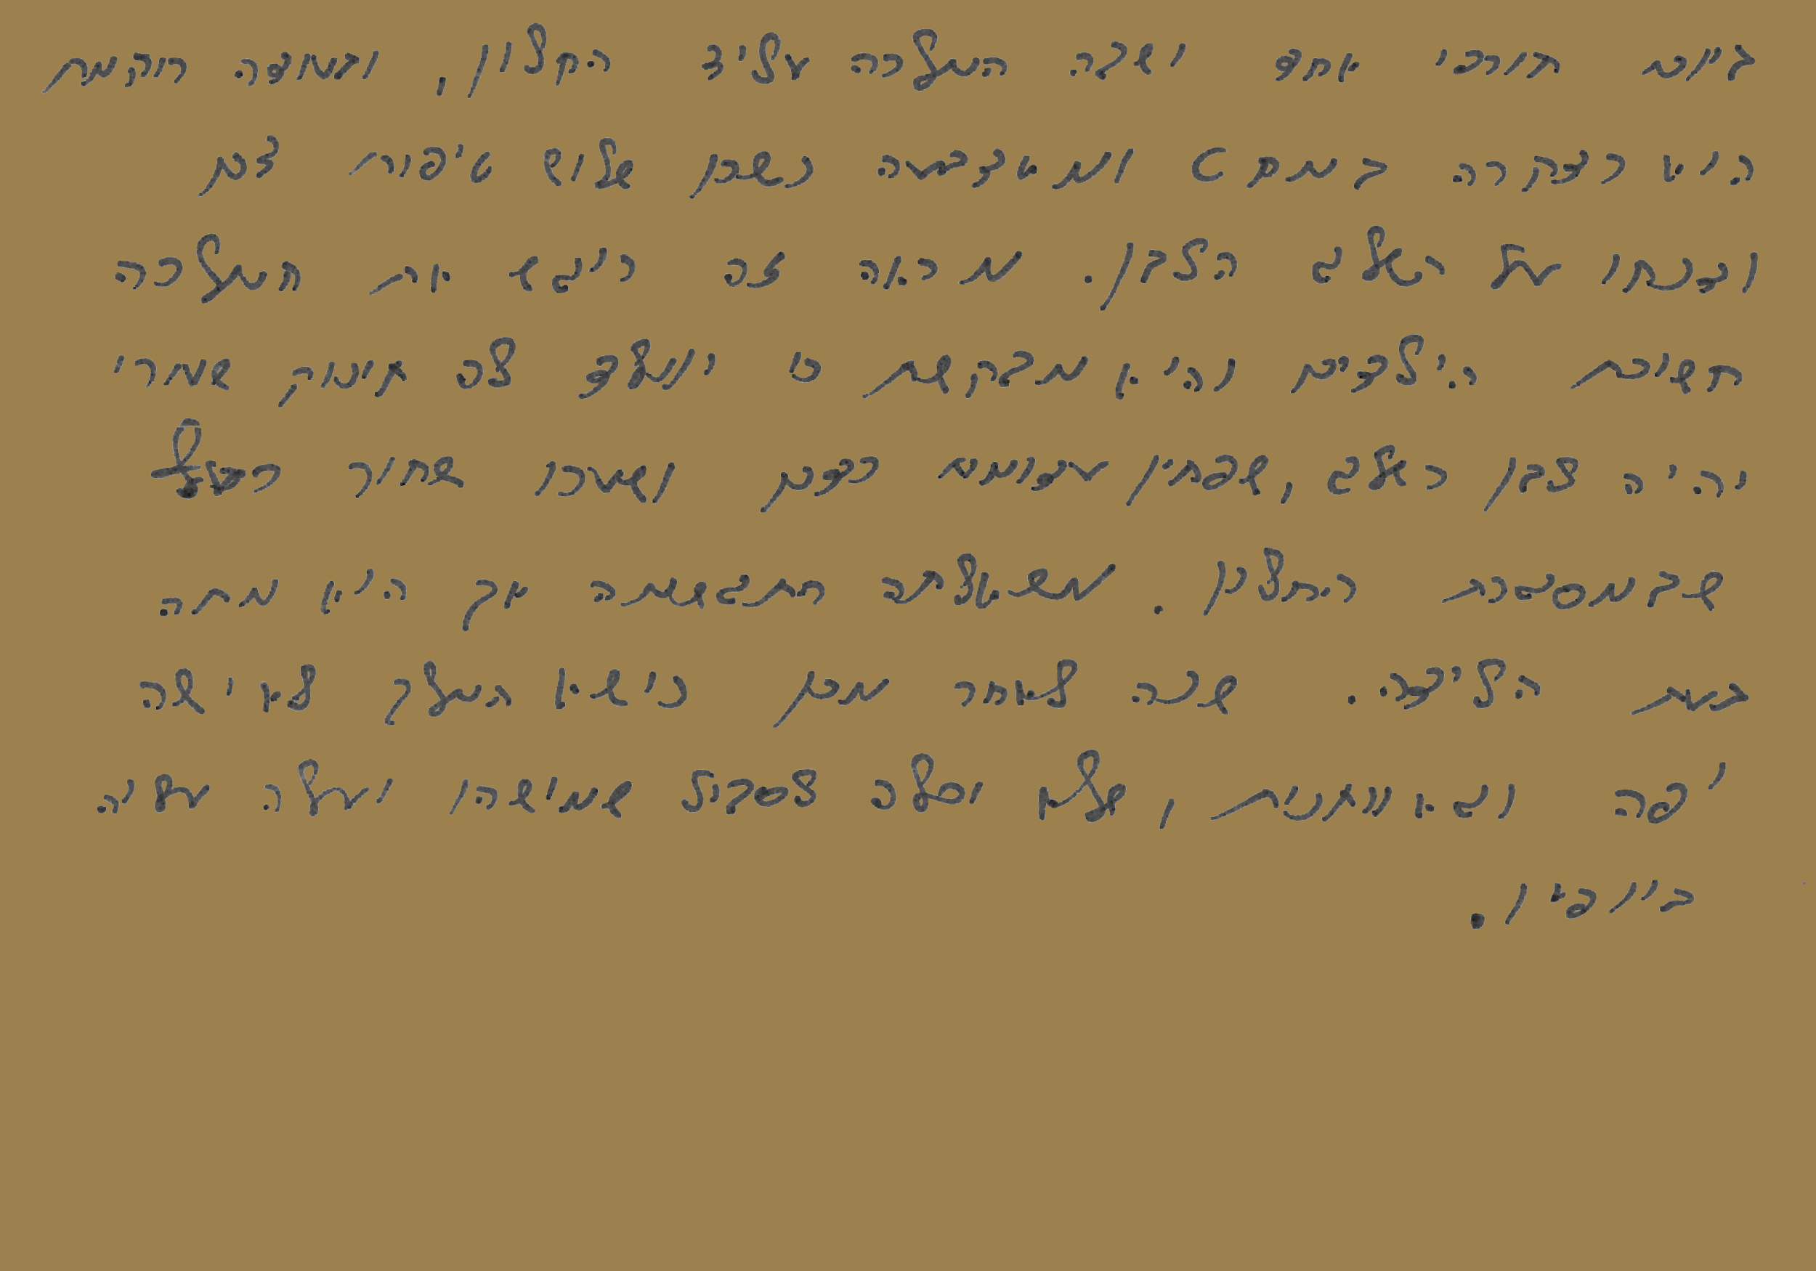
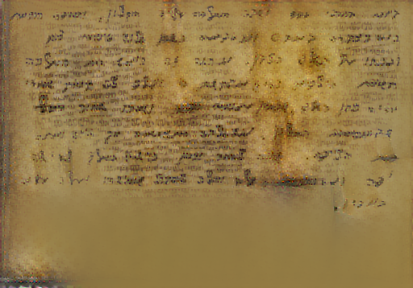
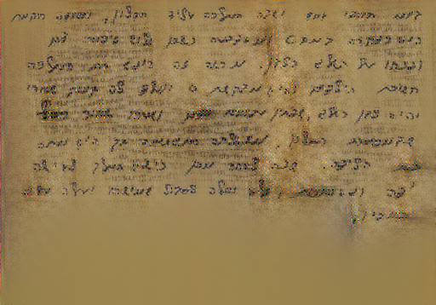
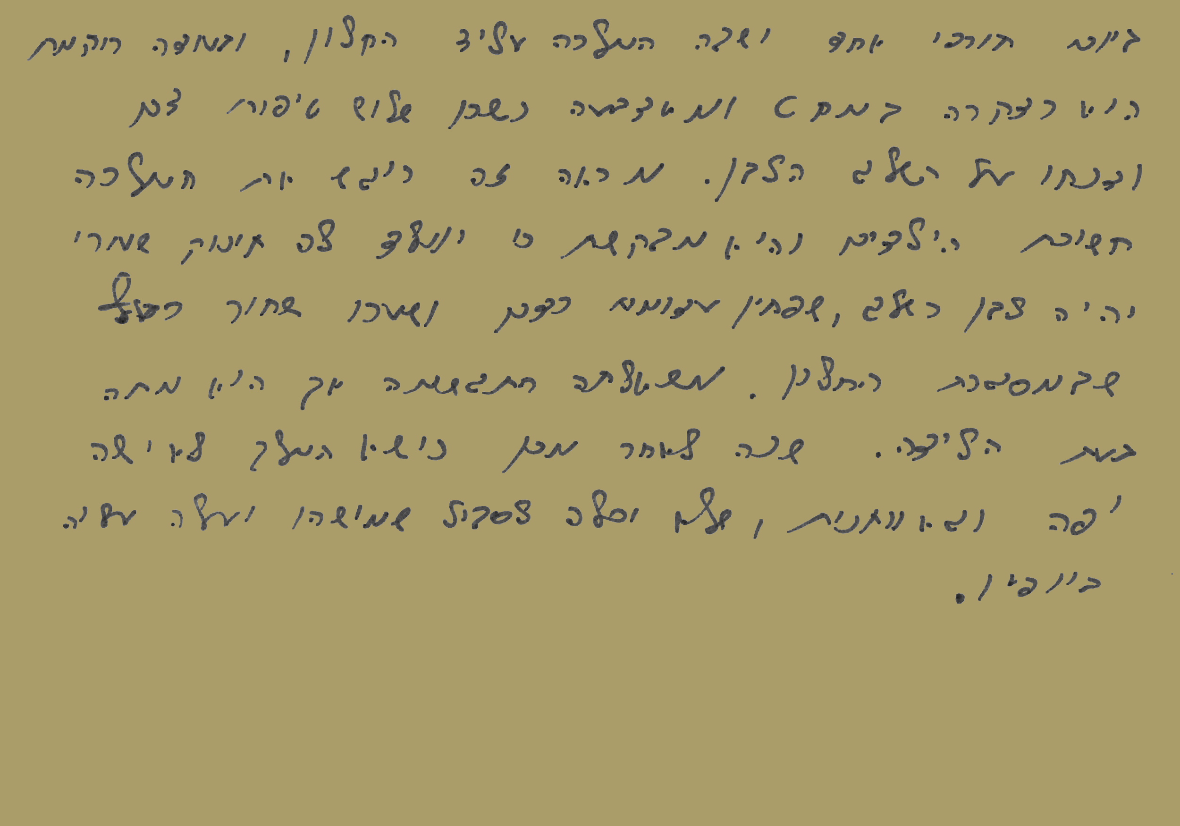
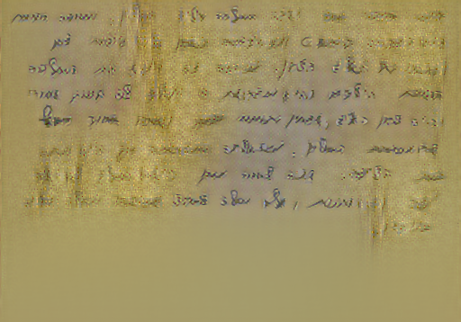
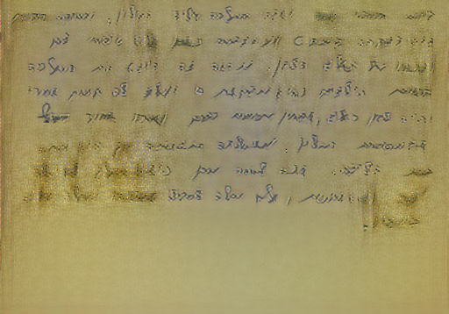
Results (6) -
Average historical pixels background for dilated content
weight 4 - block3_conv2
weight 5 - block3_conv2
weight 3 - block3_conv3
weight 4 - block3_conv2

Slide 12
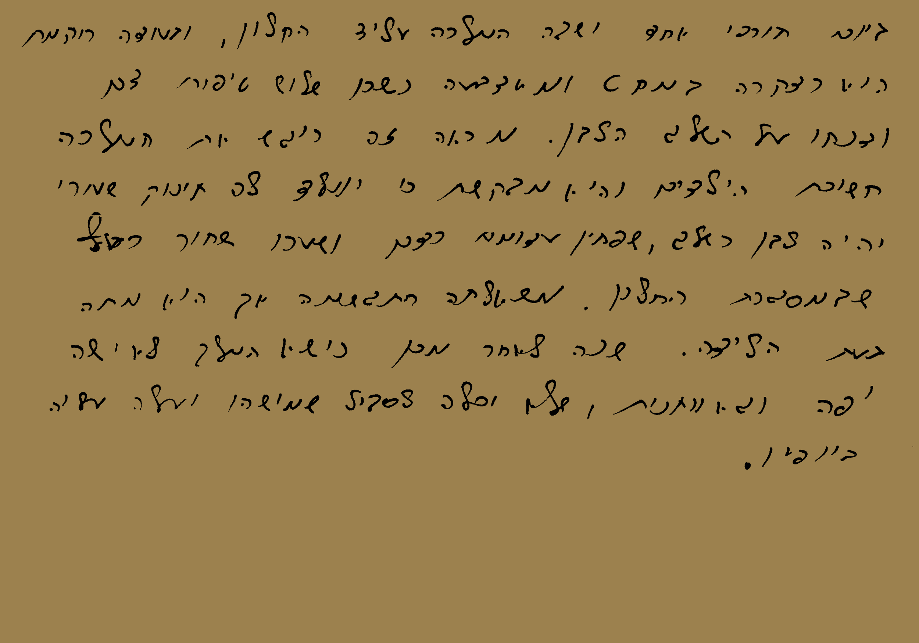
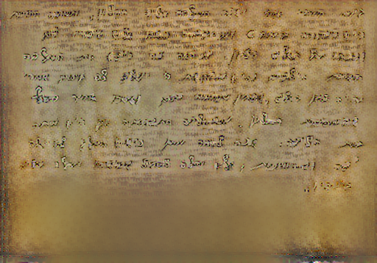
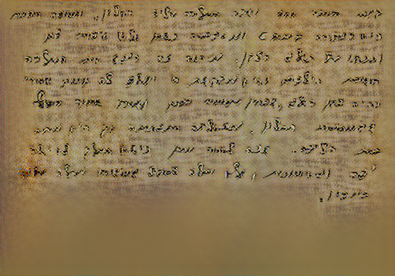
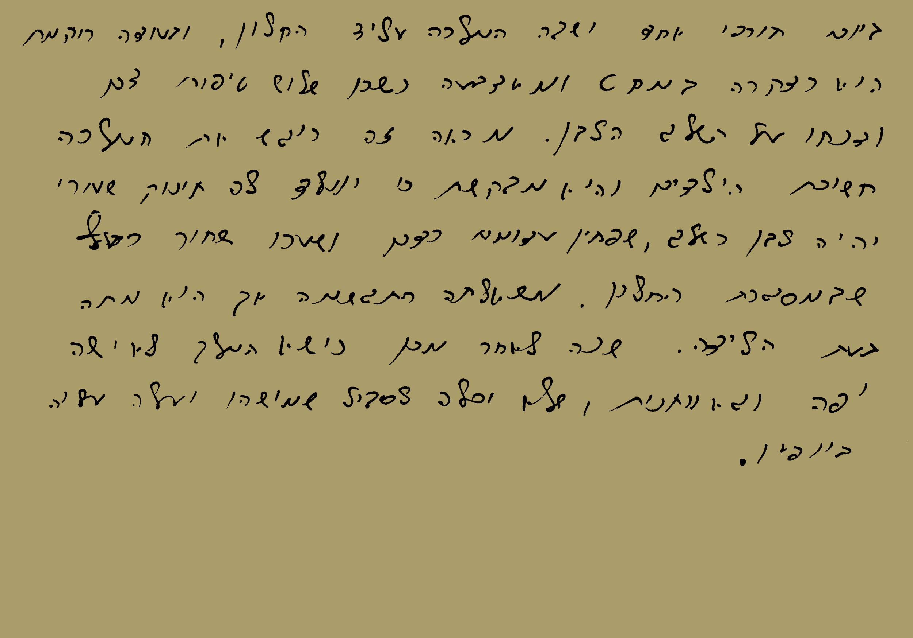
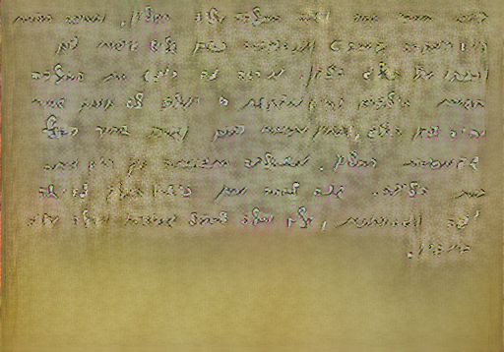
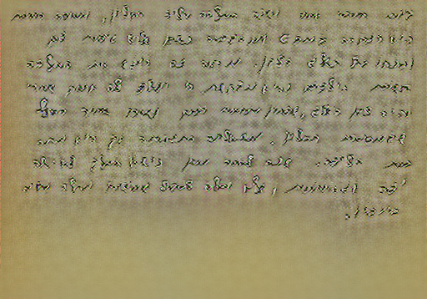
Results (7) -
Average historical pixels background for binary content
weight 4 - block3_conv2
weight 5 - block3_conv2
weight 4 - block3_conv2
weight 5 - block3_conv2

Slide 13
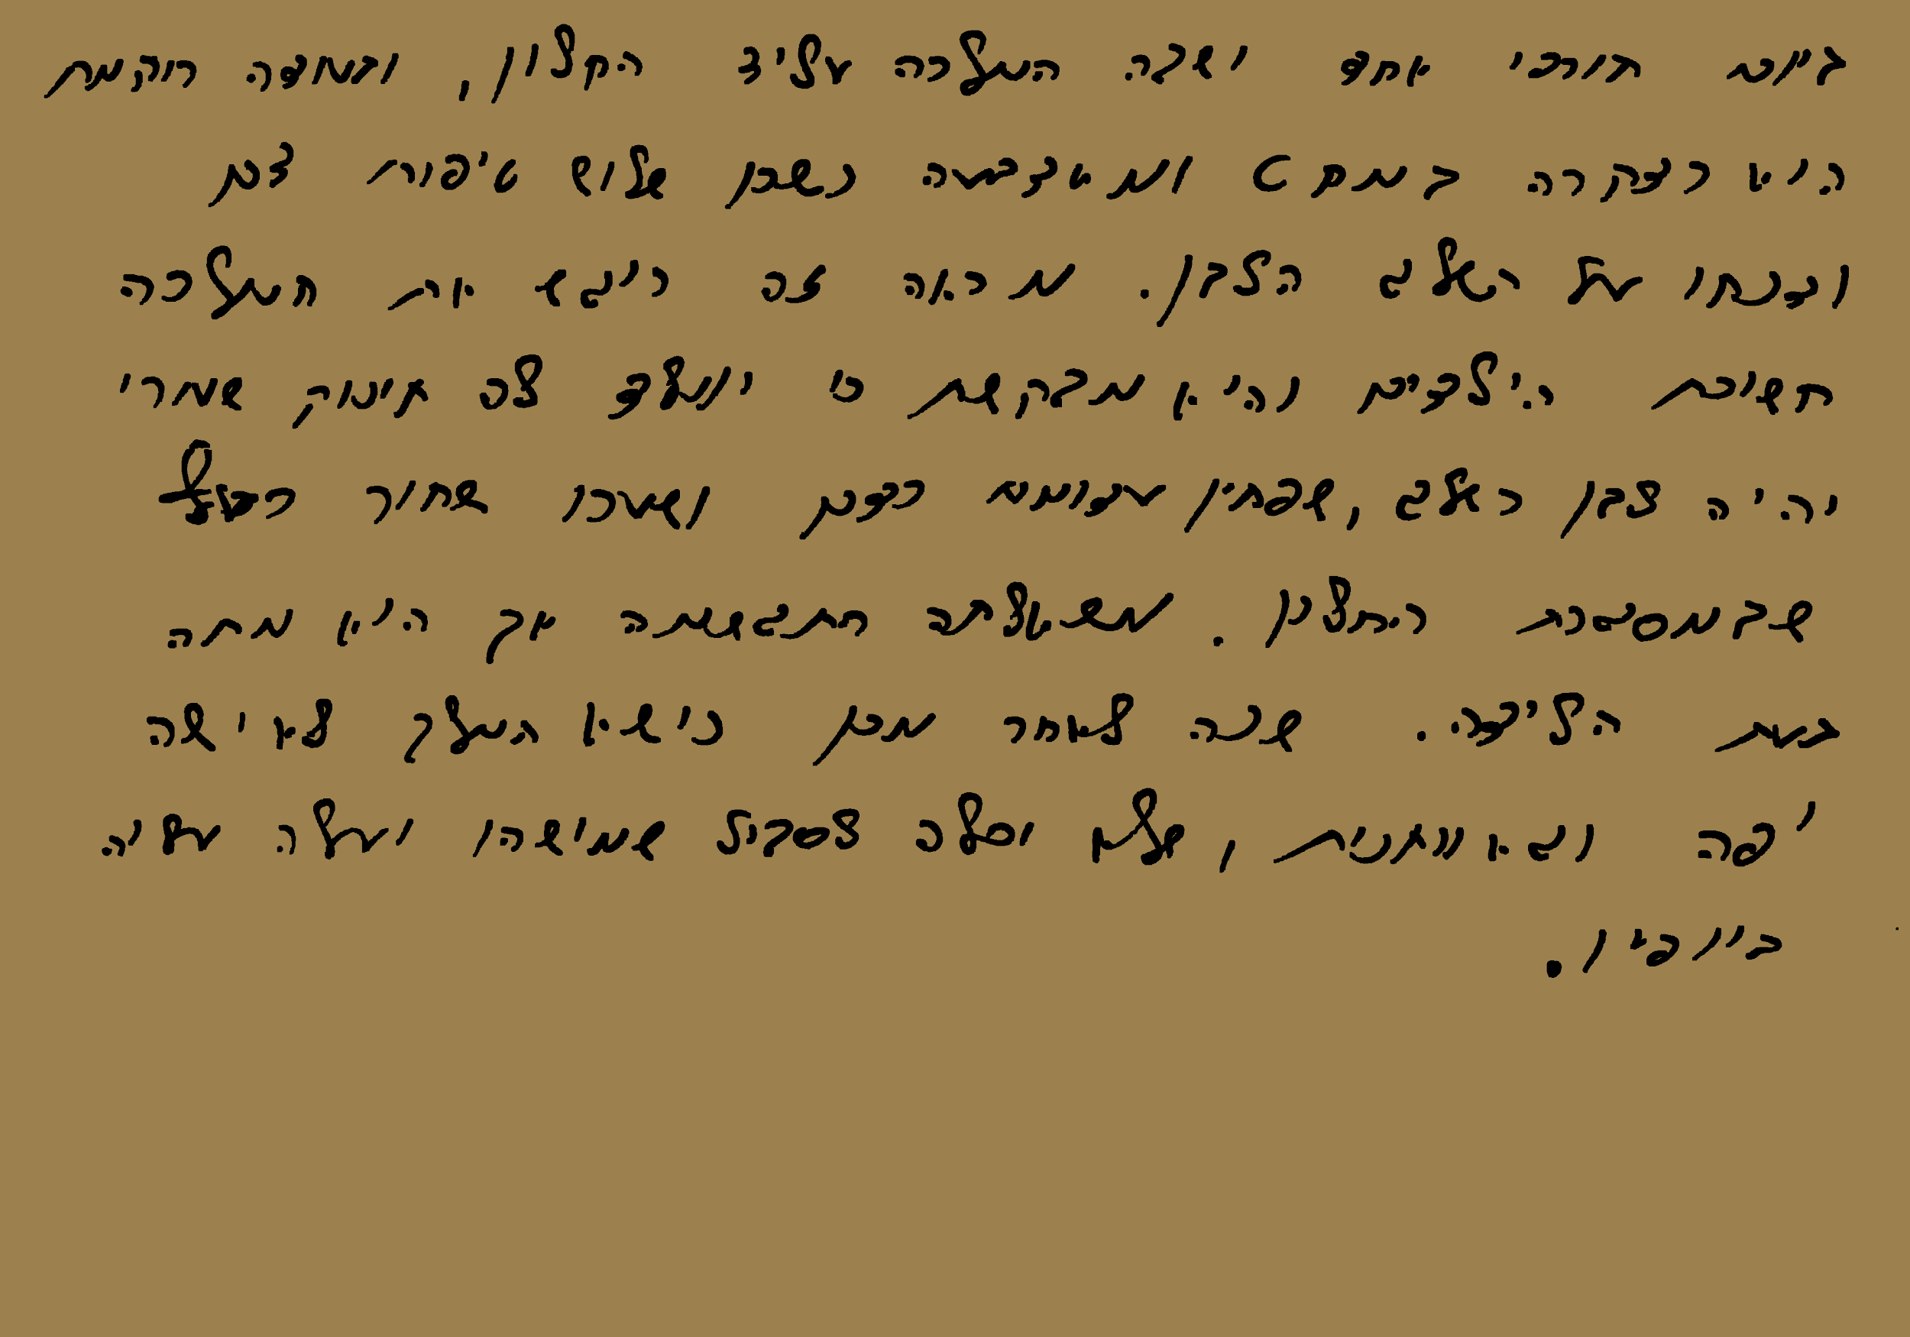
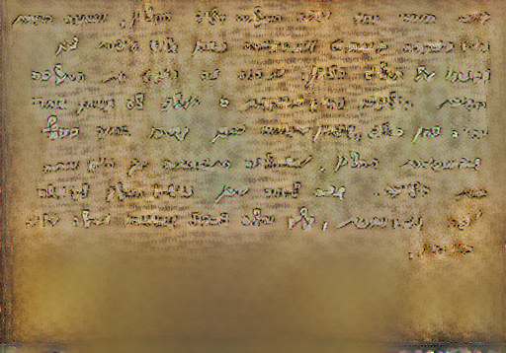
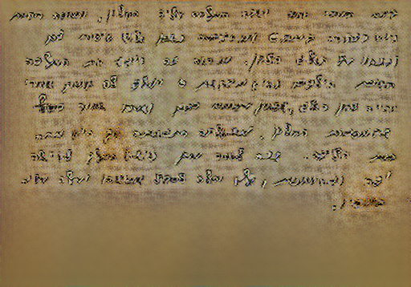
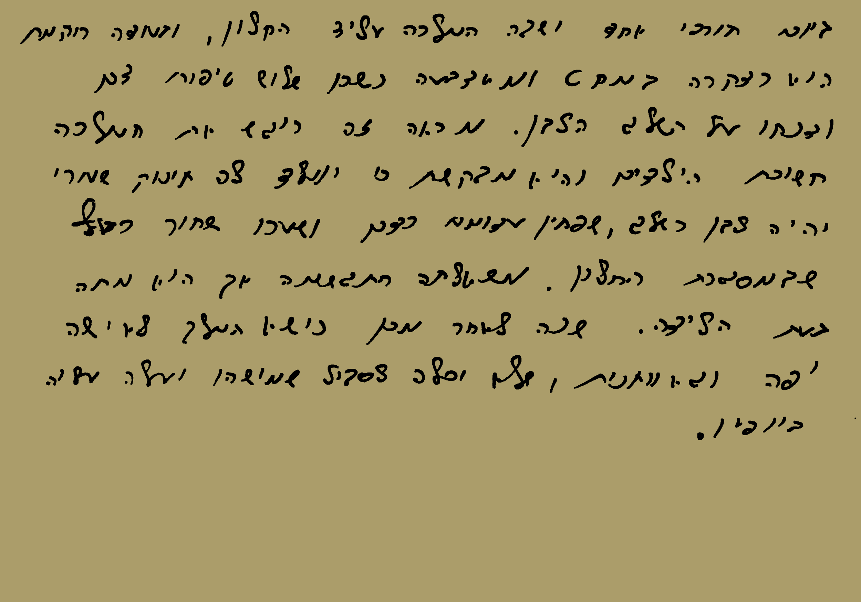
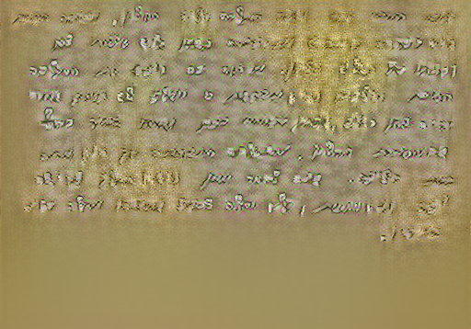
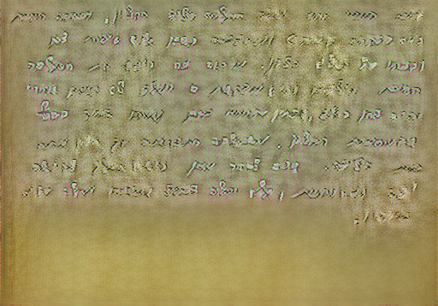
Results (8) -
Average historical pixels background for binary-dilated content
weight 4 - block3_conv2
weight 5 - block3_conv2
weight 3 - block3_conv3
weight 4 - block3_conv2

Slide 14
Project Management
Project management application:
Teamwork: Work & Project Management Software
Meetings:
Team Meetings
Academic Advisor Meetings
Timeline management:
Teamwork Gantt chart

Slide 15
Project Environment
Client side development:
Angular
HTML
CSS
TypeScript
Version control:
Github
Google Drive
Server side development:
Python
FastAPI
Uvicorn
Tensorflow
OpenCV
Diagrams:
draw.io
Research:
Google Colab

Slide 16

Requirements and Timeline

Slide 17

Risks

Slide 18

Demo

Slide 19


Thank you for your attention!

